Slide 1
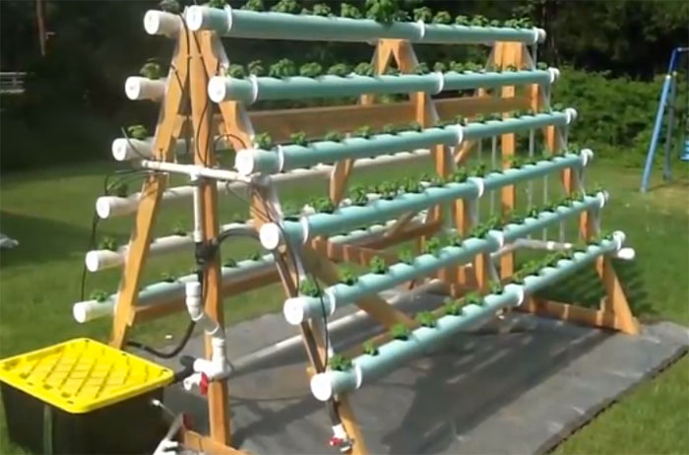
GROWINATOR
“DESTROYS YOUR FRESH VEGETABLE BILL!” –John Connor
“Has your crops saying ‘I’ll be back’ after you harvest!” –The Terminator
Zachary Blanchard
ELT2720
4/20/2016

Slide 2
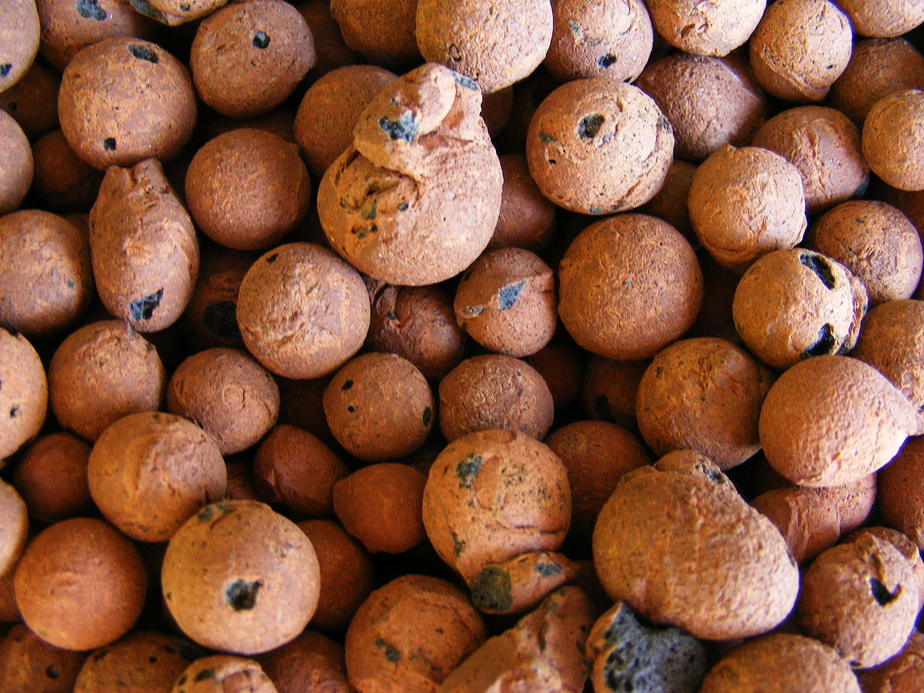
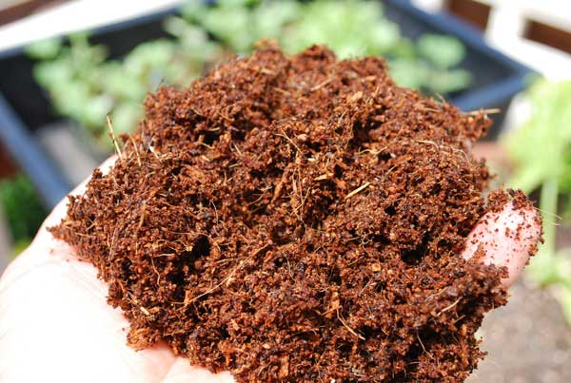
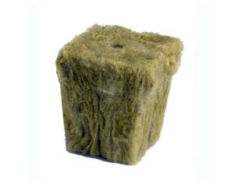
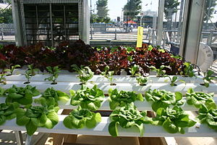
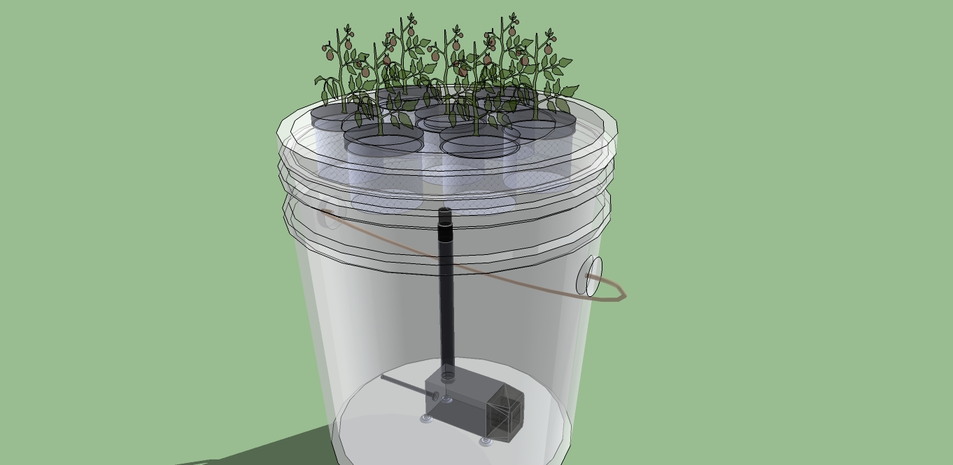
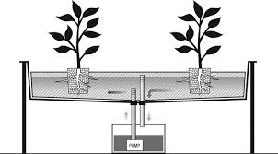
What is Hydroponics?
Soilless growing
  Perlite / Vermiculite
  Peat or Coir
  Expanded clay balls
  Rockwool
Continuous-Flow Culture
Aeroponics
Flood and Drain Sub-Irrigation

Slide 3
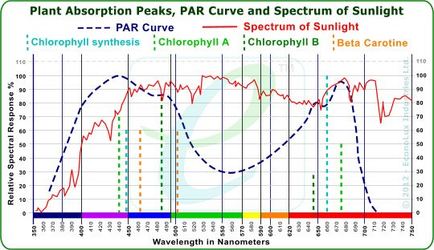
Light Spectrum and Growing
Two Wave Bands to focus on:
  Blues:
    Critical to plant grow
    Where Leaves are growing and the majority of upward growth comes from
    Only place where plants produce Beta Carotine
  Reds:
    Where plants form flowers
    Necessary for anything that “fruits”

Slide 4

Nutrients
Nitrogen
Phosphorus
Potassium
Miscellaneous Minerals
PH Level

Slide 5
Problem Statement
Design a self functioning hydroponic system
Proper light spectrum
Self watering when needed
Sized to function in an indoor environment

Slide 6
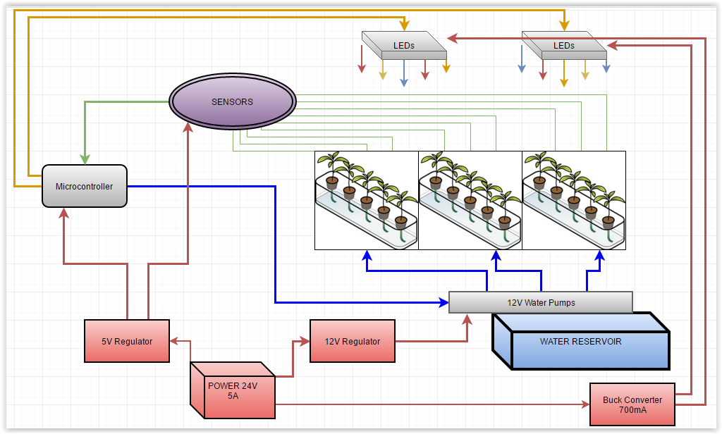
The System

Slide 7
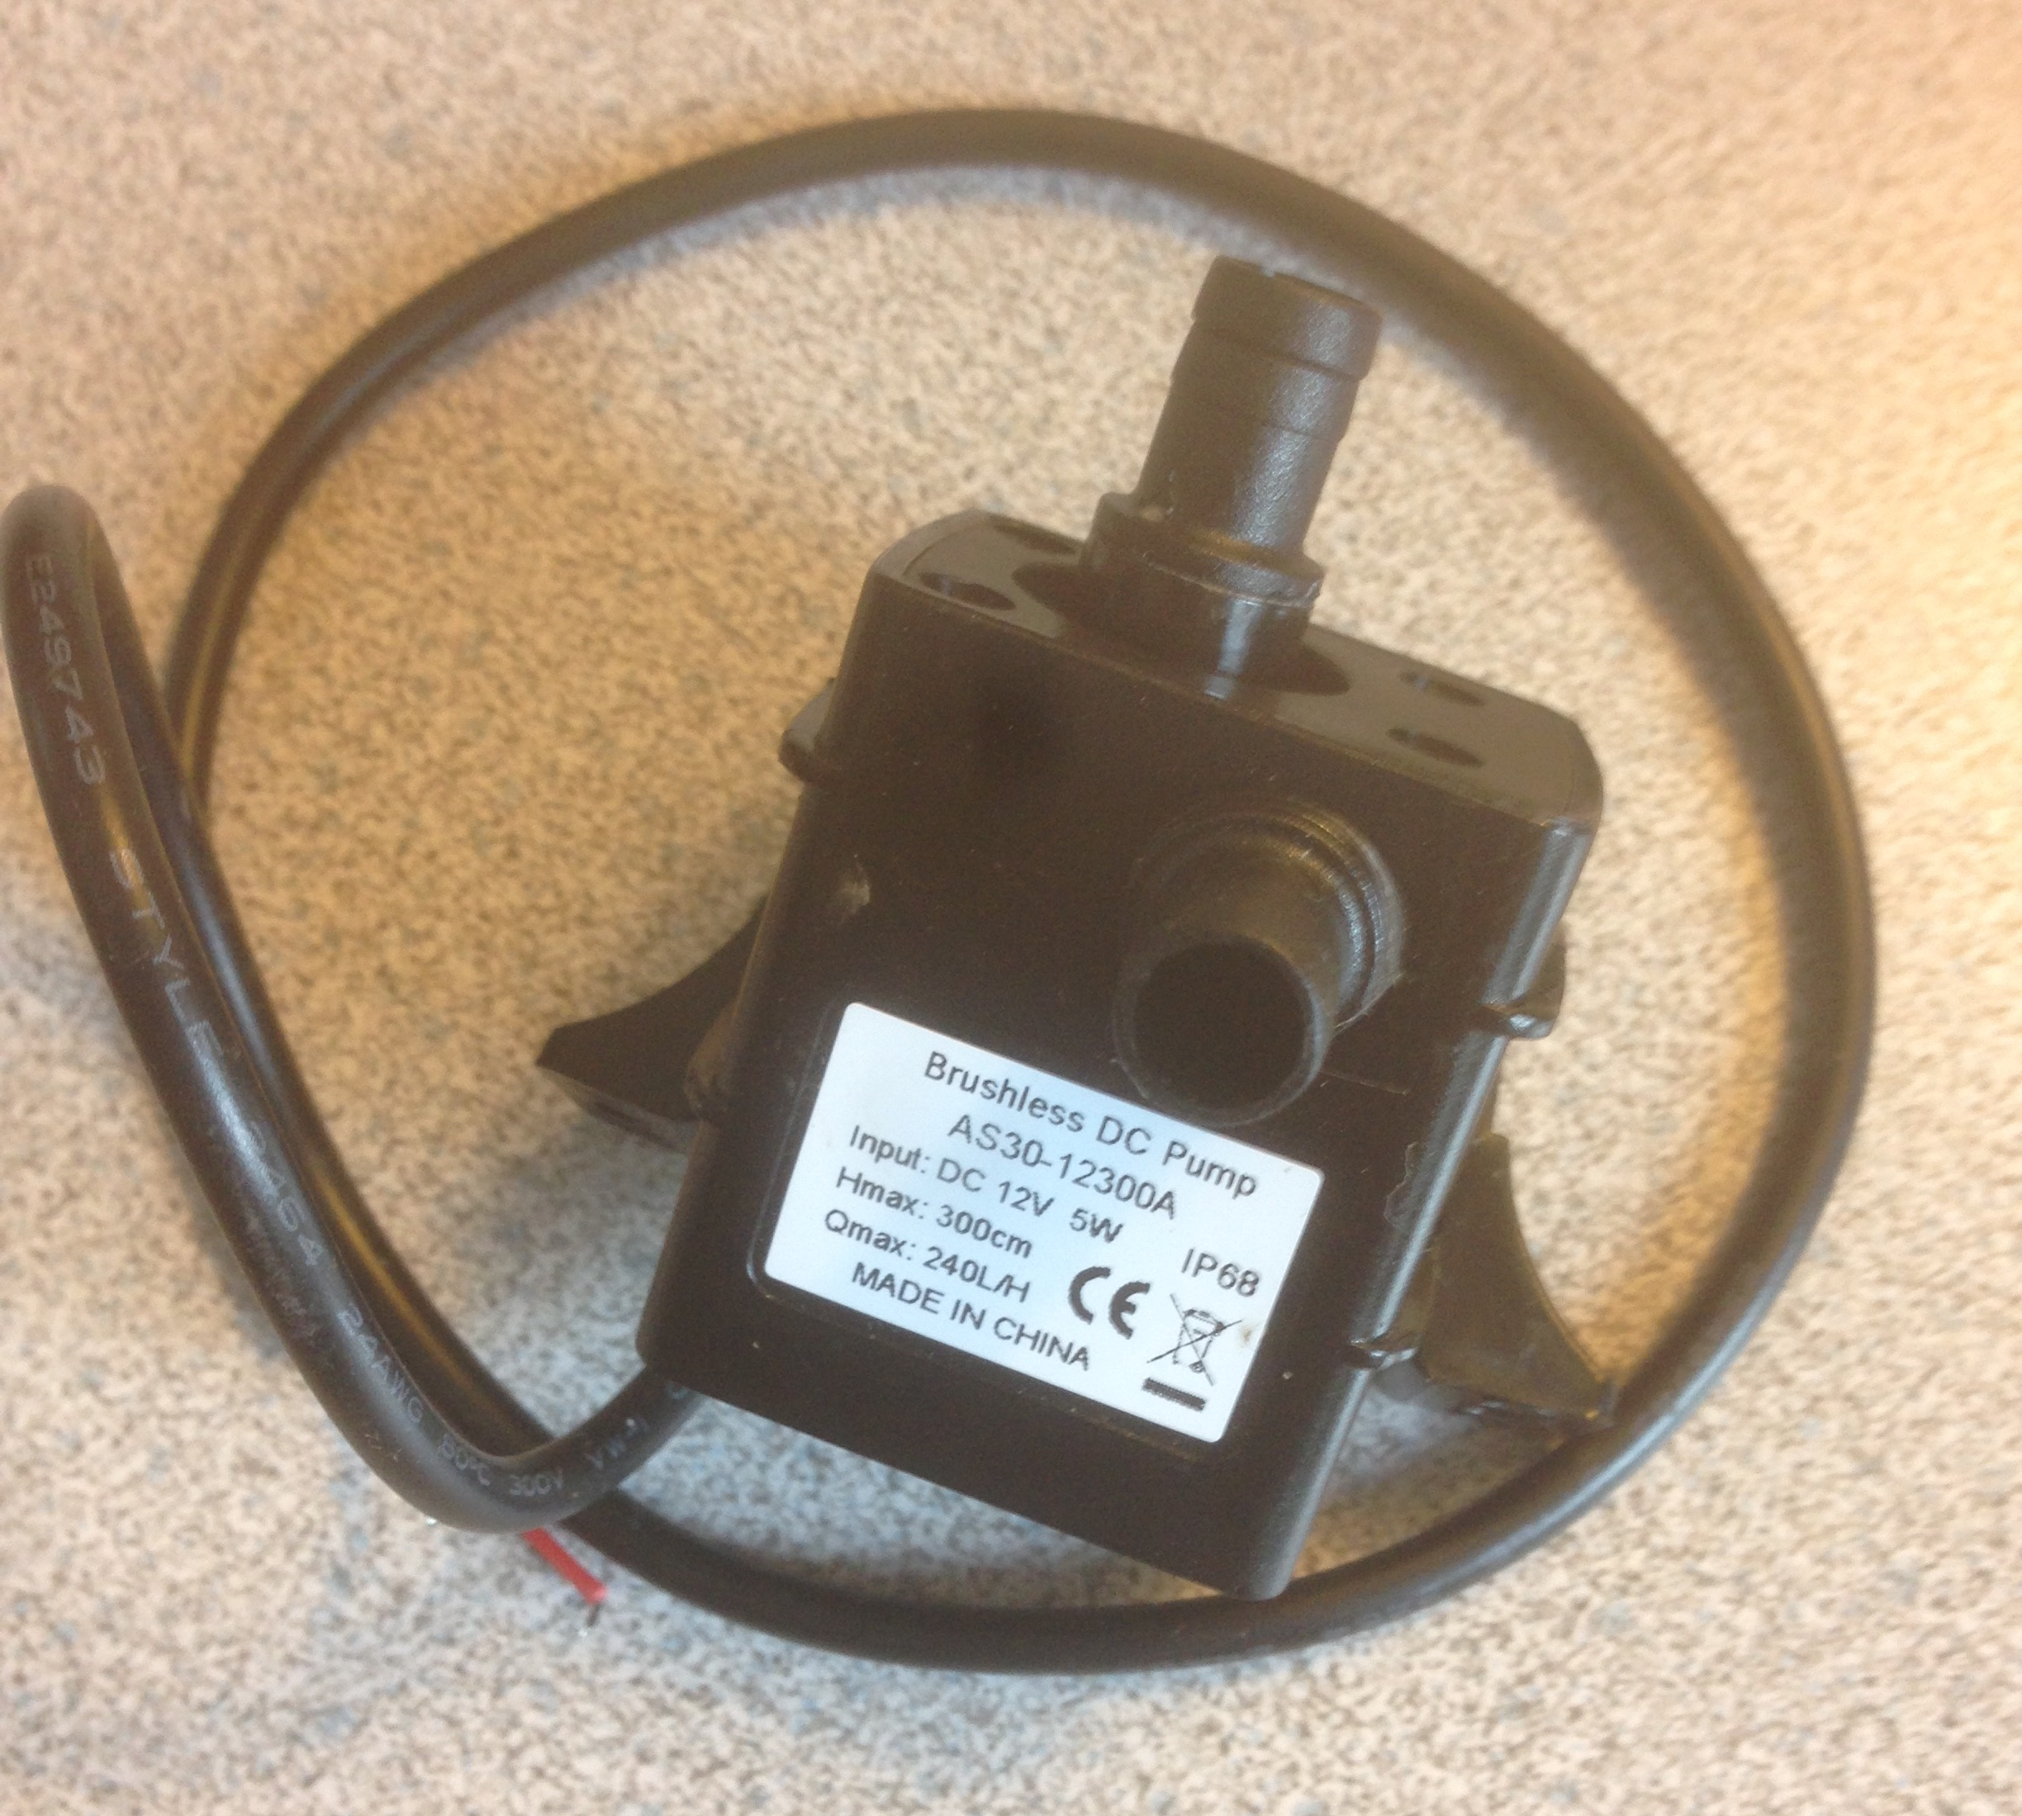
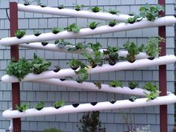
WATER SYSTEM
Large diameter PVC Tubing
Gravity fed
10 gallon reservoir
Pumps:
  Submersible
  12v .4A water pump
  STATIC LIFT of 3m
  240 liter/hour

Slide 8
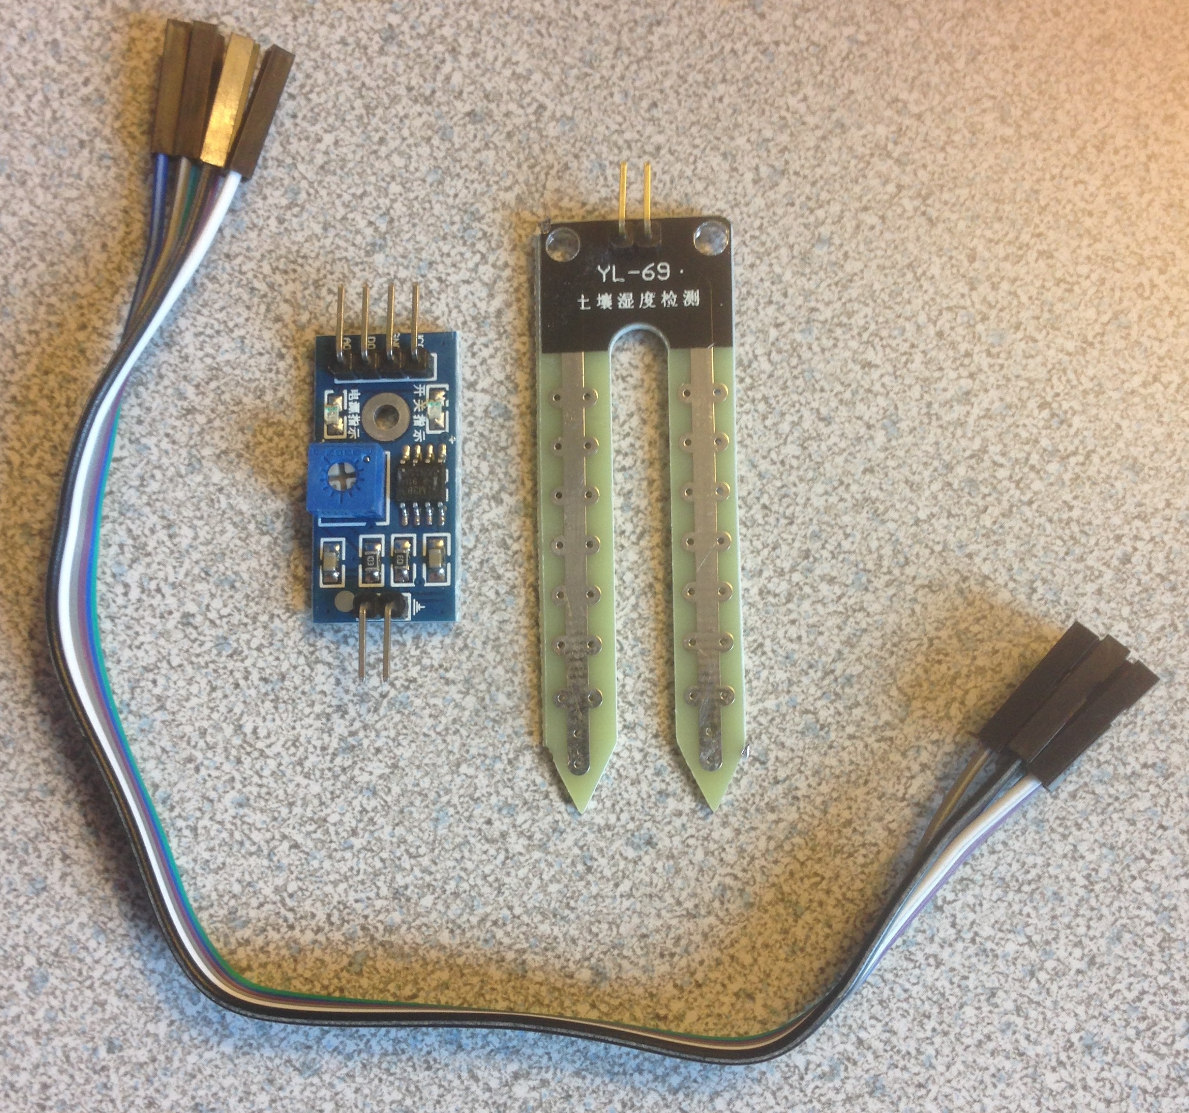
Moisture Sensors
3.3v~5V in
Choice of analog or digital out
  Digital:
    Trim pot for switching level
    Lm393 comparator
  Analog:
    Voltage out of 0~4.2

Slide 9
SENSOR TESTS
 | DRY | MOIST | WATER
SENSOR 12bit Micro output | 4095 | 2730 | 1692
 | 4095 | 3235 | 2550
 | 4095 | 3279 | 1414
 | 4095 | 3166 | 1695
 | 4095 | 3229 | 1701
Mean | 4095 | 3127 | 1810
Using ANAlog for accuracy
Wide range meant it was not necessary for an amplifier

Slide 10
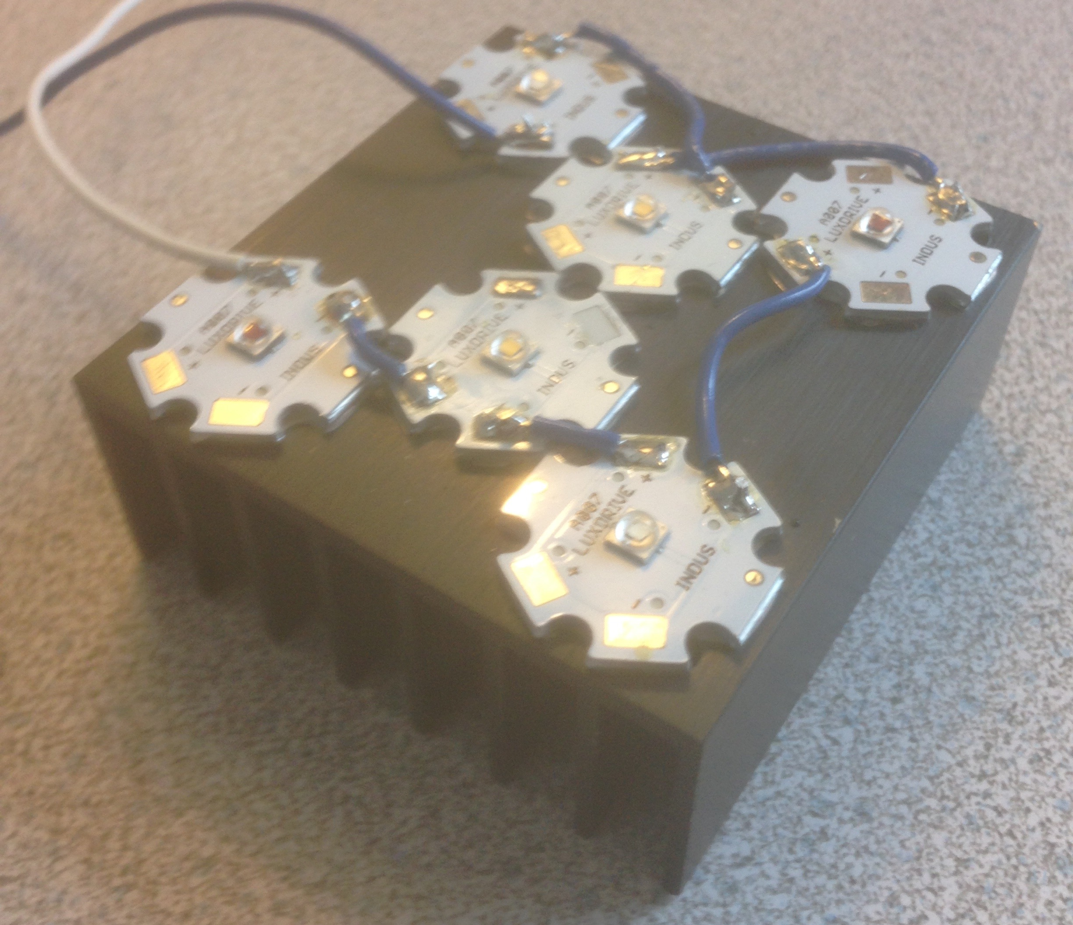
LIGHTING SYSTEM
Cree XP-E 3W LEDs
  2 White
  2 Red
  2 Royal Blue
Measured Forward Voltage
  16.93V
  16.86V
Large Heat Sink
  Heating concerns for Red LEDs

Slide 11
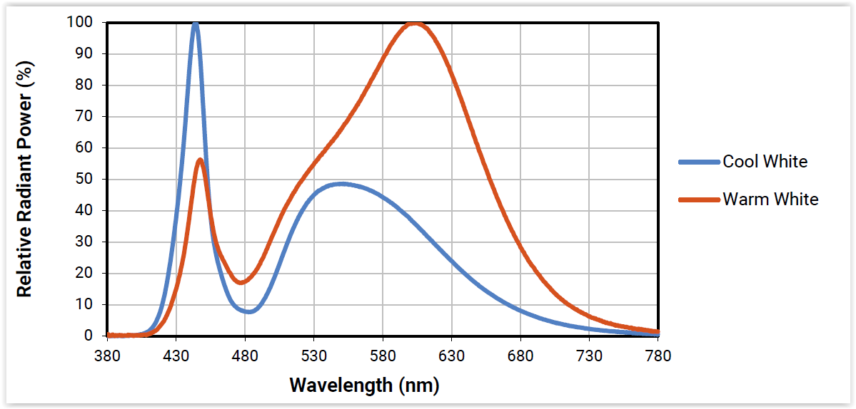
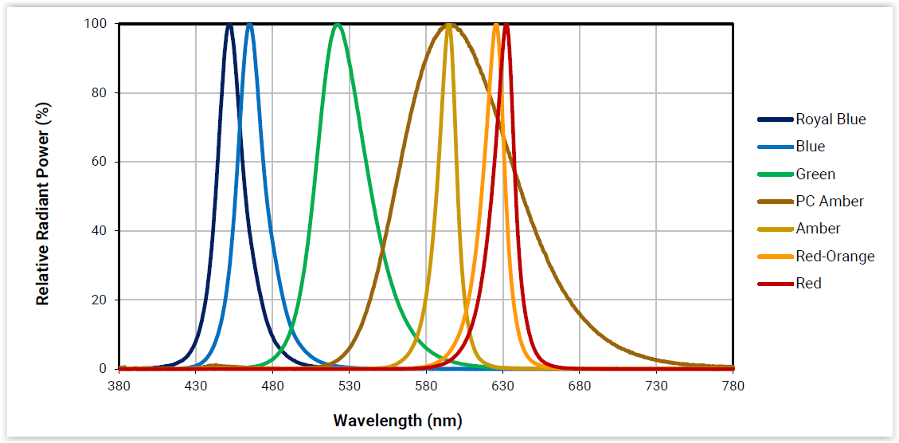
WAVELENGTH
From CREE datasheet:

Slide 12
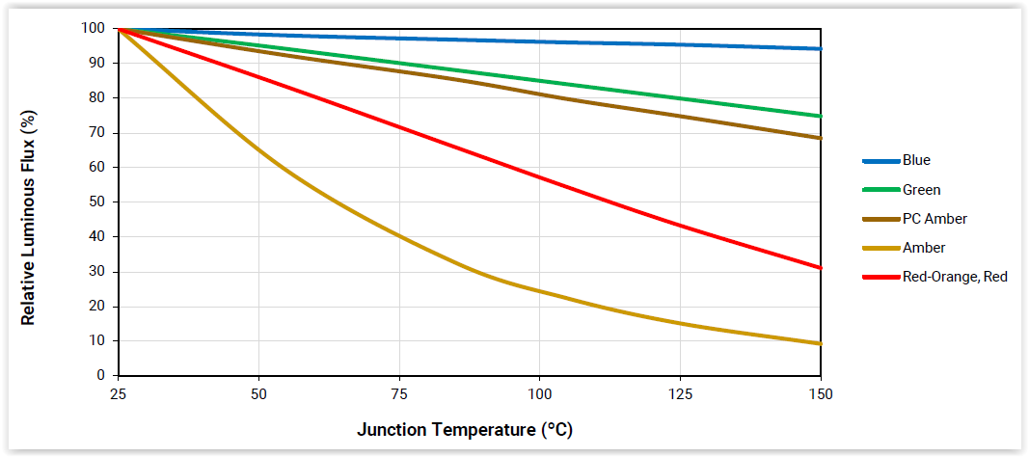
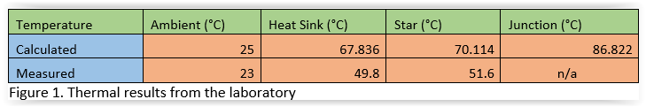
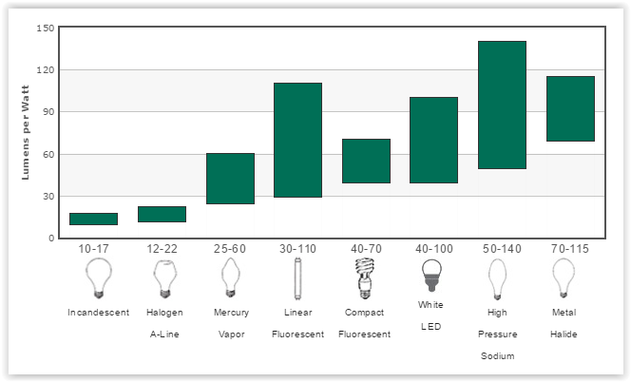
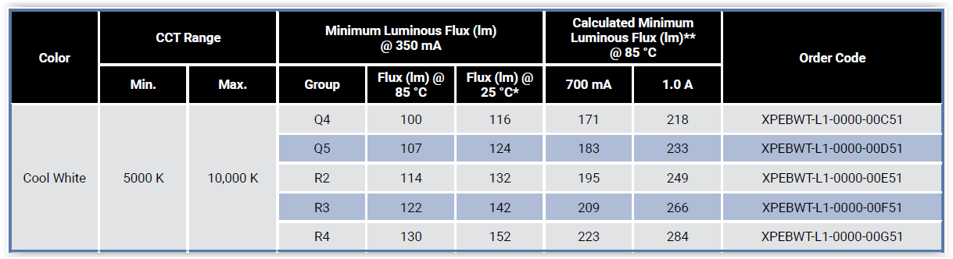
HEAT CONCERNS
And Light output
Red LEDs lose light output fast with heat
Large heat sink:
  4.7°C/W
Industrial light output:
  110-140 Lumens/Watt

Slide 13
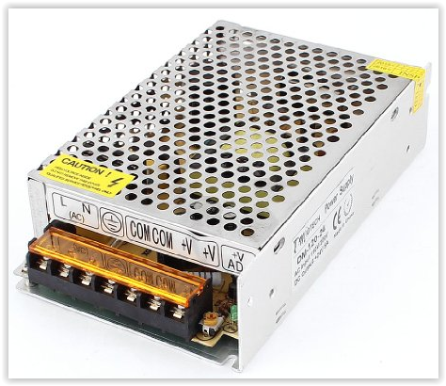
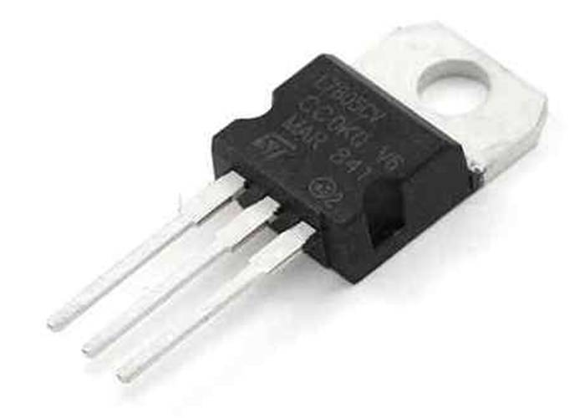
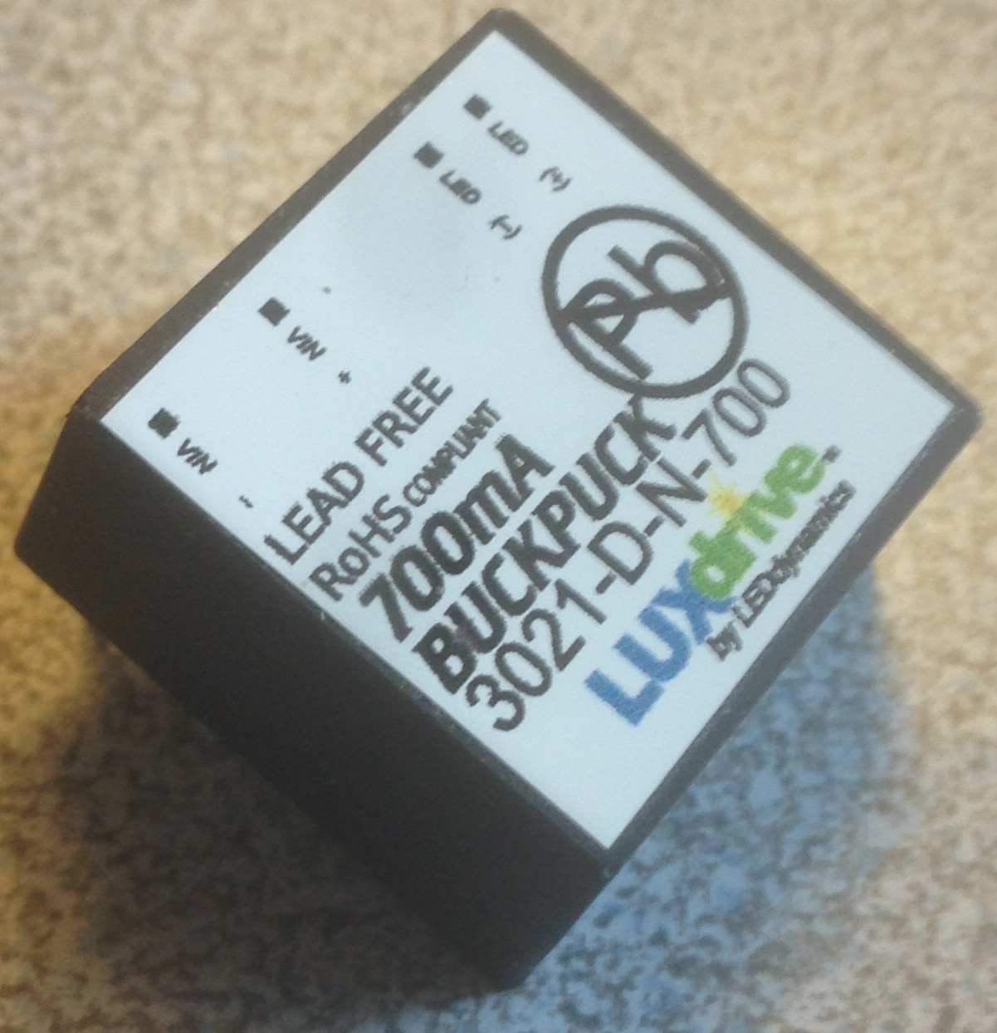
POWER:
Main Supply
  24V 5A
LM7805
  Down to 5V
LM7812
  Down to 12V
Buck Converter
  Constant 700mA

Slide 14
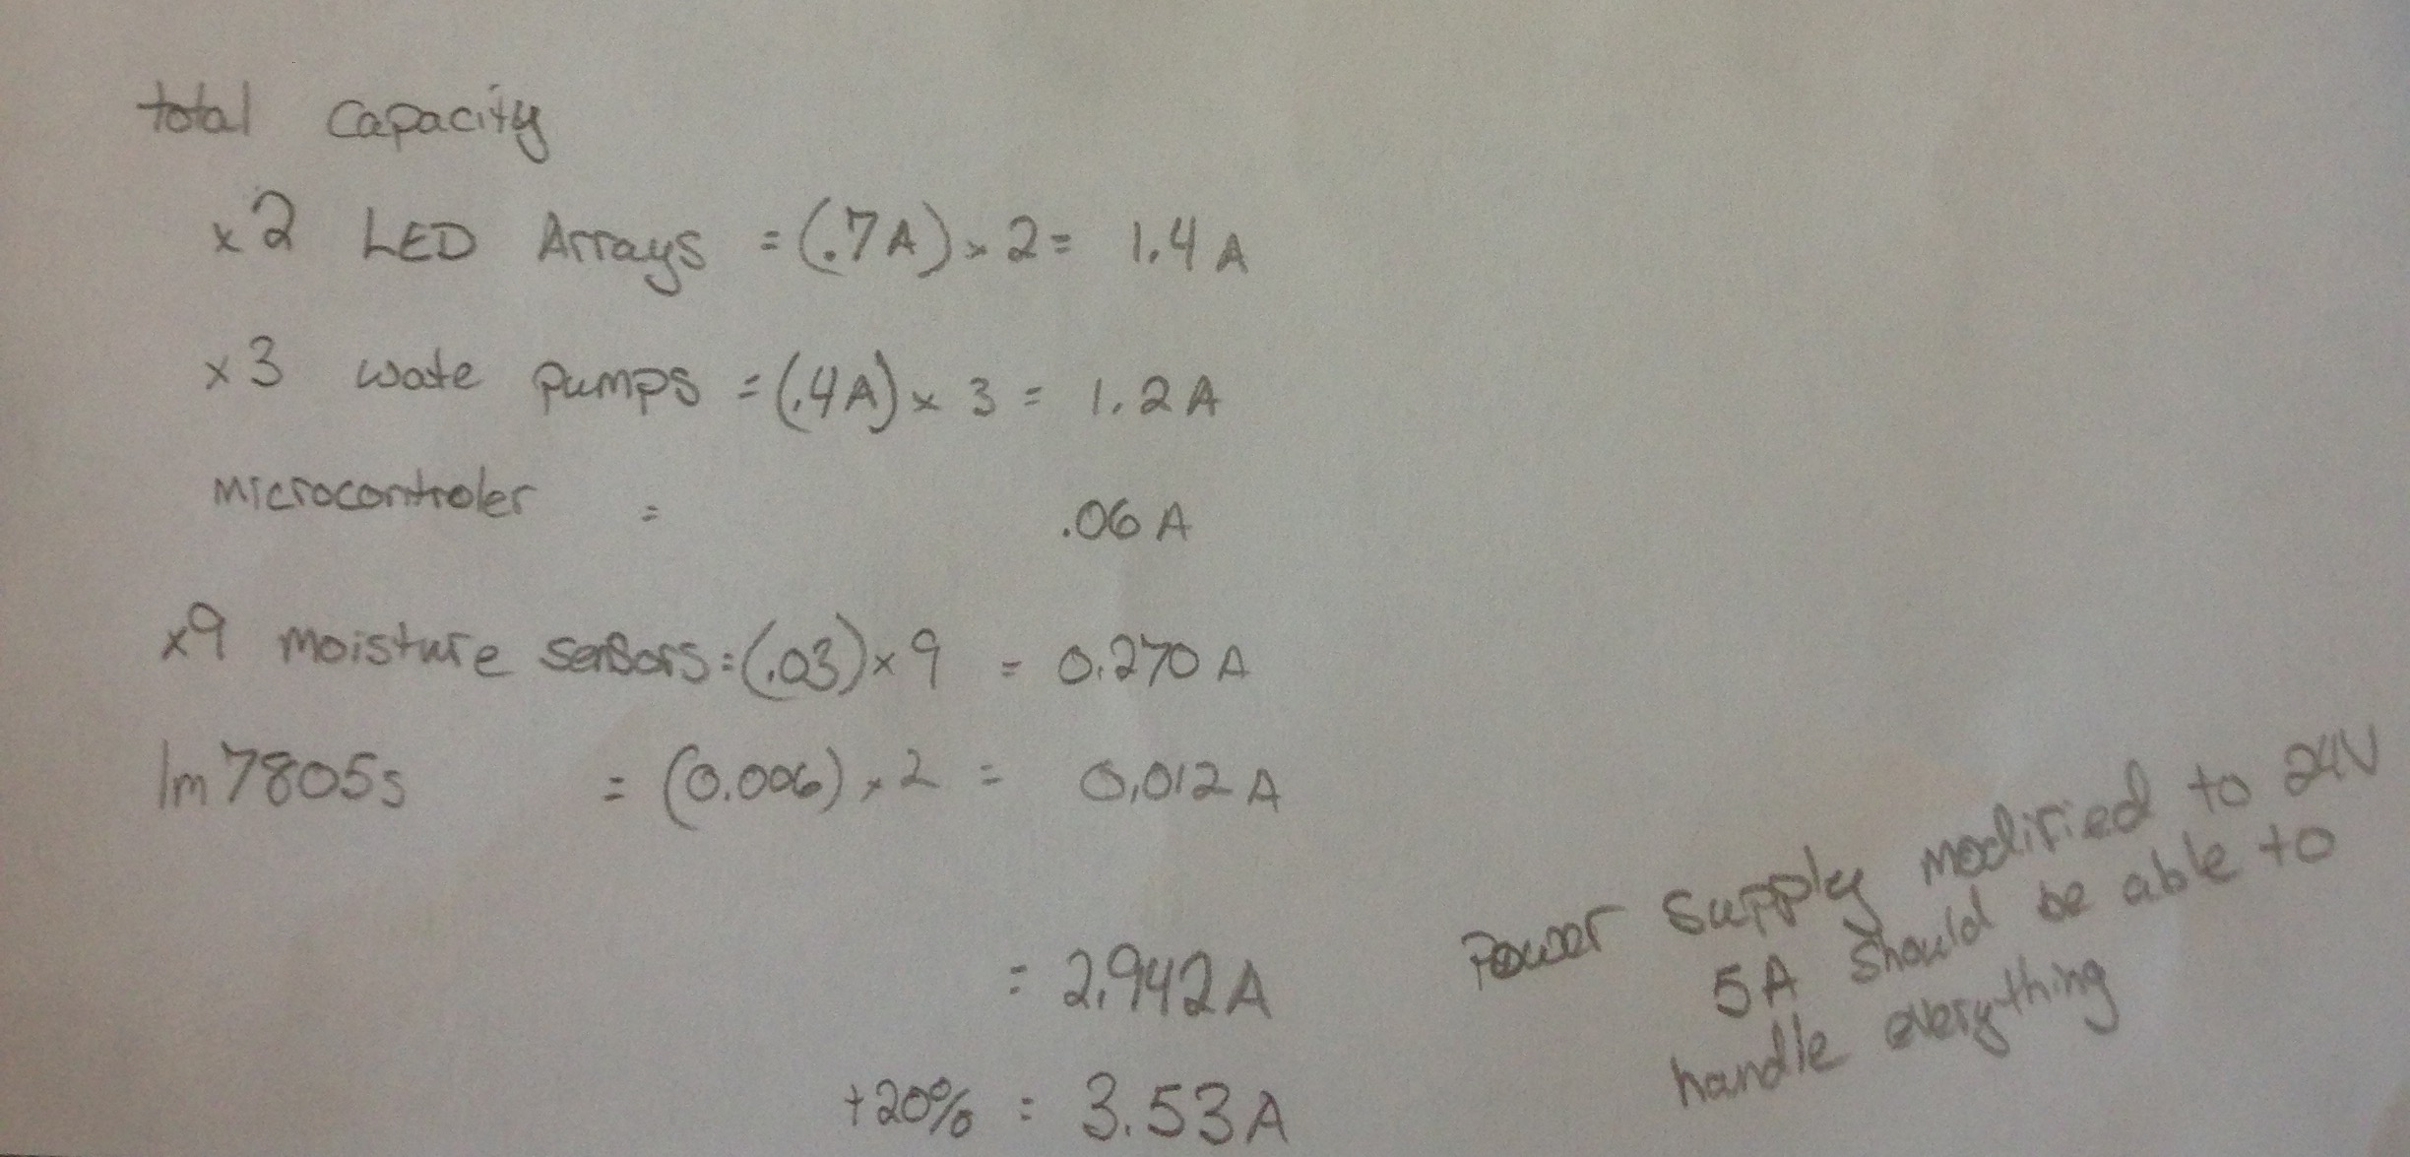
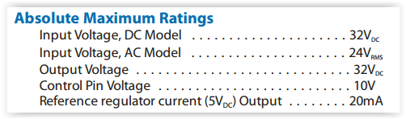
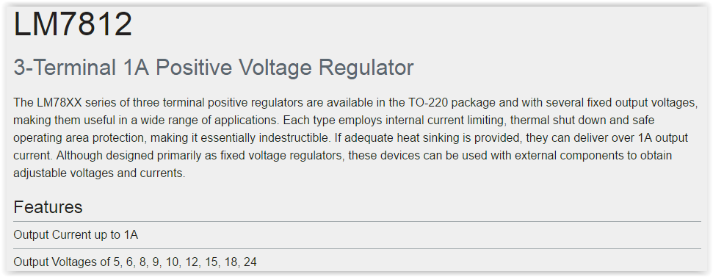
POWER REASONING:
24V 5A standard supply
  Cost effective
  Allows Expansion of system
LM78XX
  Easy onboard fix
BUCKPUCK
  Allows for LEDs up to 32V forward voltage

Slide 15
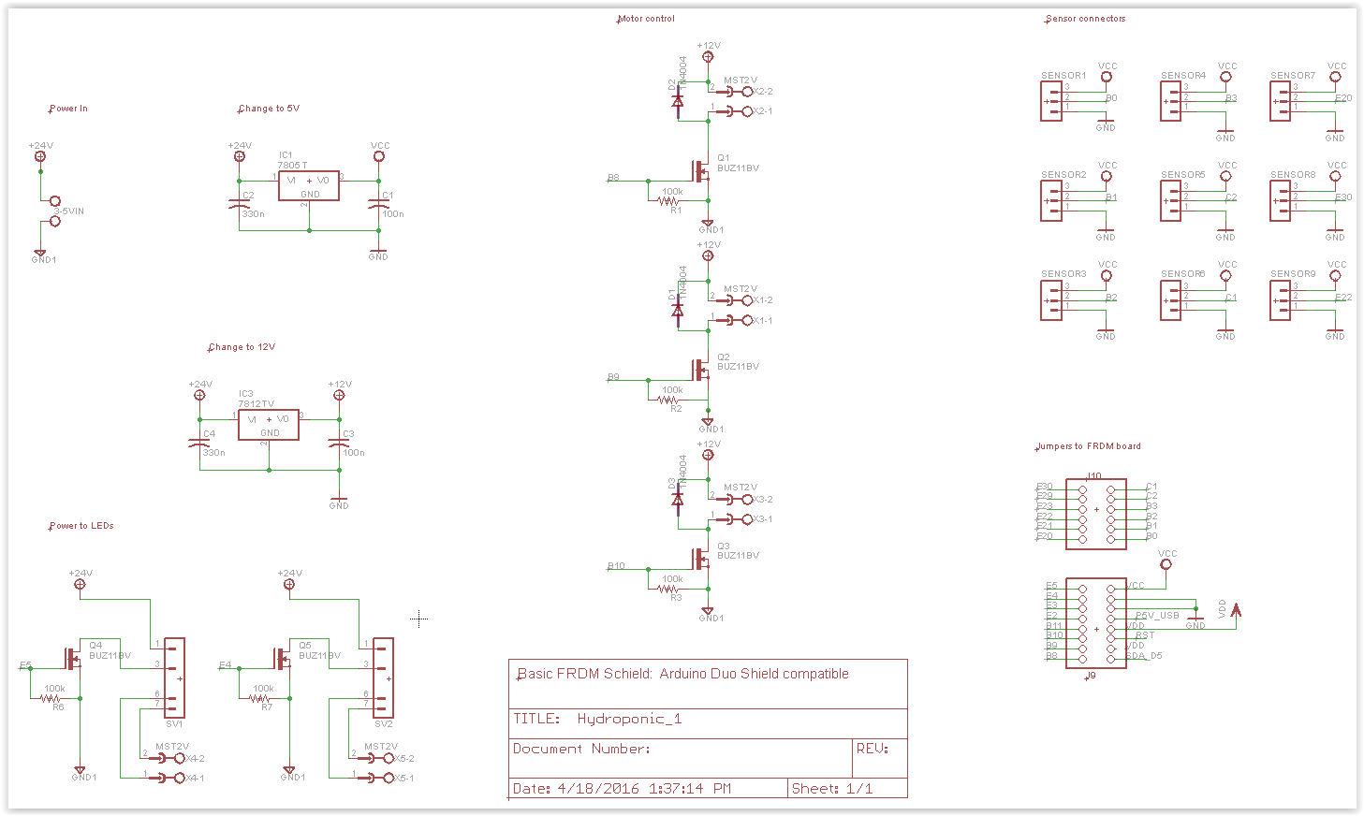
Schematic

Slide 16
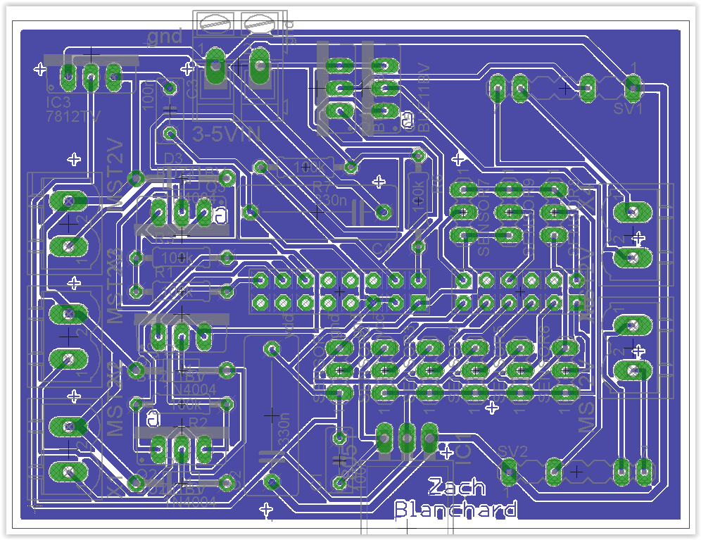
BOARD LAYOUT

Slide 17
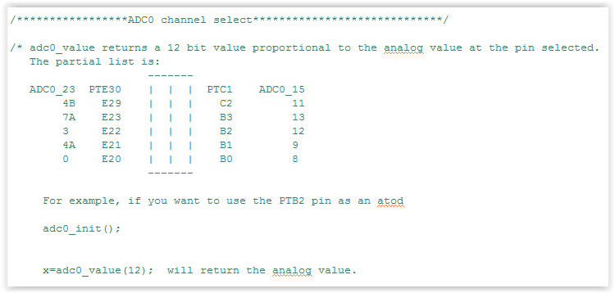
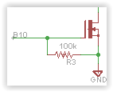
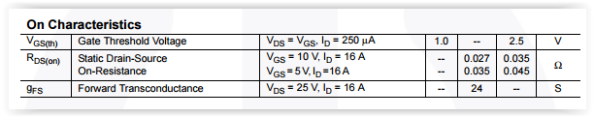
PIN ASSIGNMENTS
And Switch choices
Need 9 Analog to Digital Converters
2 GPIO pins for the LED arrays
3 GPIO pins for the water pumps
Need a 5 switches for the arrays and pumps
N-channel MOSFET
  On voltage well within the 3.3V output from the micro
Fairchild FQP30N06L
  60V 32A Max
  1~2.5V On gate voltage

Slide 18
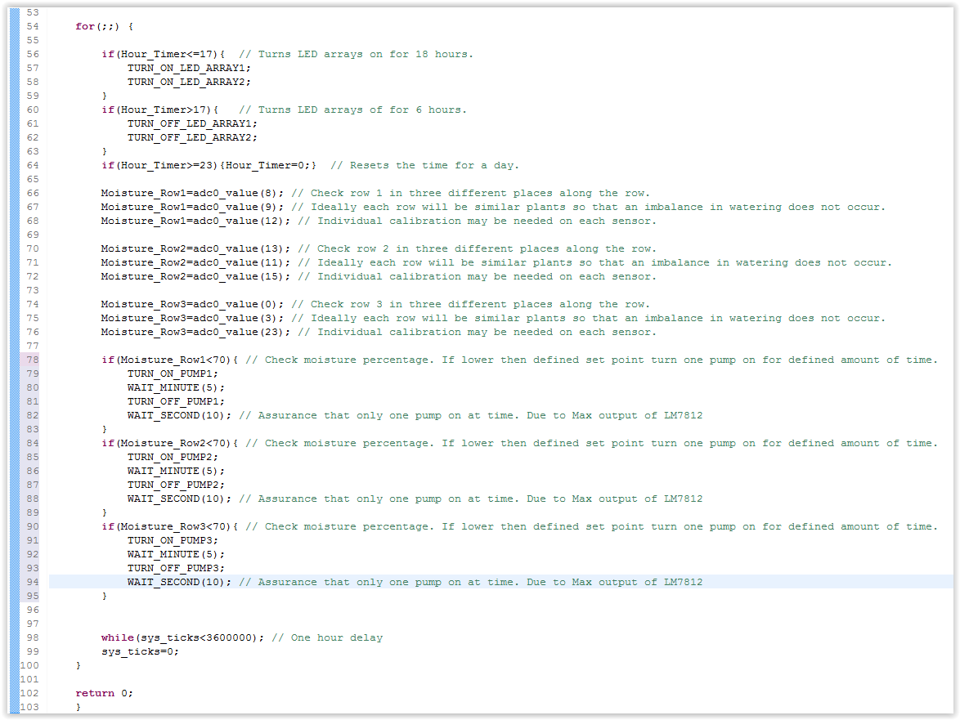
Programming
Delay functions for timing
Assurance that only one pump is on at a time due to constraints of the LM7812
Define length of time LED arrays are on for
Checking sensors and checking them against a defined percentage
Maintain a moisture content

Slide 19
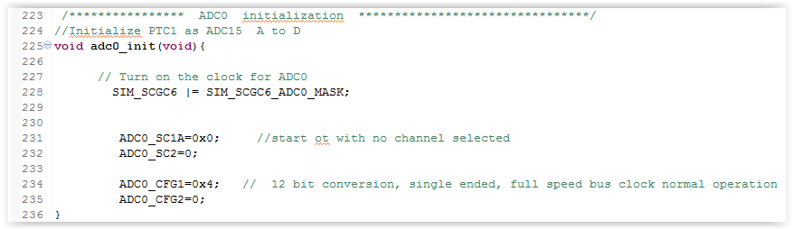
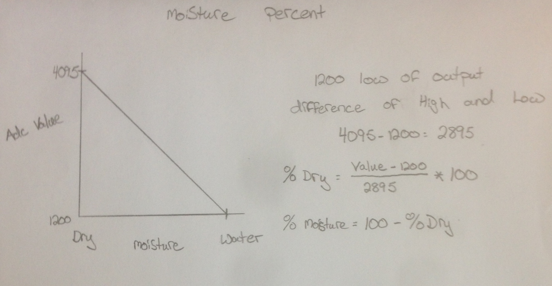
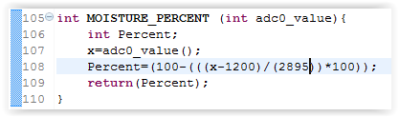
Programming COntinued
Set up ADC as a 12 bit converter
Find a way to determine moisture percentage in the planting medium
Set up a function to determine this

Slide 20
Ethical Concerns:
Low Power
  Use of Two 12 Watt LED arrays opposed to 400~1000 Watt traditional high insanity grow bulbs.
  Less On-Time with pumps since they are only turning on when moisture gets to low. Opposed to continuous flow that is traditionally always on.
Knowing what you are putting into the plants
  You will know and can decide on pesticides that may or may not need to be used. Opposed to just guessing with grocery store vegetables.
  You will decide upon the nutrients used and can decide whether or not to grow fully organic.
Price/Satisfaction/Health
  Organic vegetables are expensive!
  Producing your own food is satisfying to many people!
  Having plants in your house naturally cleans the air!

Slide 21
THANK YOU for Your Time
QUESTIONS?

